Slide 1
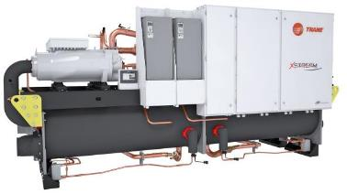

Slide 2
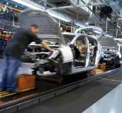
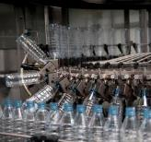
Your expectations in one product
Sustainability
Capacity
Efficiency
Versatility
Reliability
kW

Slide 3
Ready for a Sustainable future
0 ODP
Near Zero GWP (<1)
XStream™ chillers with near zero GWP refrigerants are part of the Ingersoll Rand EcoWise™ portfolio of products that are designed to lower their environmental impact with next-generation, low global warming potential (GWP) refrigerants and high-efﬁciency operation.

Slide 4
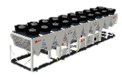
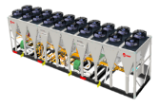
A unique portfolio for your needs
High Speed Centrif. Technology
GVWF G
GVAF
GVAF XPG
R134a
GVWF
R1234ze
RTHD
RTWD
RTWF
RTHF
RTWD G
RTWF G
RTHF G
New in
2018
RTAF
RTAF G
New in
2017
Screw Technology

Slide 5
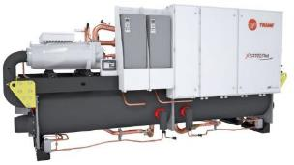
LARGEST CAPACities in the industry
RTWF G
2 circuits - 3 or 4 compressors
Cooling capacities: 12/7°C Entering/Leaving evaporator - 30/35°C Entering/Leaving Condenser

Slide 6
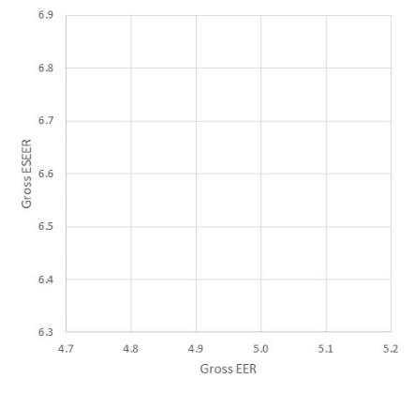
One platform, Flexible design
Best Value
for Money
RTWF HSE G
Up to 5.1 EER
Up to 6.8 ESEER
HSE
RTWF HE G
Up to 5.2 EER
Up to 6.7 ESEER
HE
Criteria
RTWF SE G
Up to 4.9 EER
Up to 6.6 ESEER
First
Cost
High
Efficiency
SE
*Efficiencies of units with R134a refrigerant

Slide 7
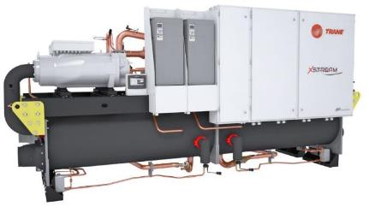
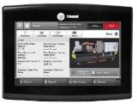
UNIT DESIGN
1
Compressor
Direct drive, low speed
Load matching down to 15% of full load
3
4
1
2
Heat Exchangers
Cross Flow Serial Heat Exchangers design
Trane patented evaporator design
New condenser design
Designed to convert Trane compressor design into premium performance at all applications
2
3
Controls
Fastest controls of the industry
Safe VPF
No nuisance trips (Adaptive controls)
Temperature control within 0.3C
4
Adaptive Frequency™ Drive
Industry leading Seasonal Efficiency
Eliminates inrush current

Slide 8
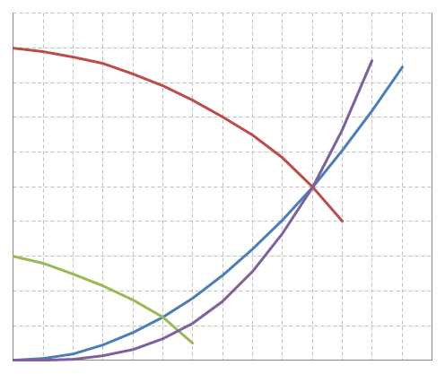
VARIABLE FLOW for PrEMIER SYSTEM EFFICIENCY
Full speed
Benefits
Less pump power for more system efficiency
80% part load = 51% pump power
60% part load = 22% pump power
50% part load = 12.5% pump power
Constant temperatures
Accurate stable controls
Lower speed:
Lower pump wear
Less noise in piping and valves
Capacity increase of existing infrastructure
Pressure Drop
Pump Power
100%
100%
Reduced speed
25%
12.5%
Flow Rate
50%
100%

Slide 9
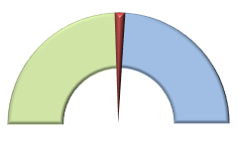
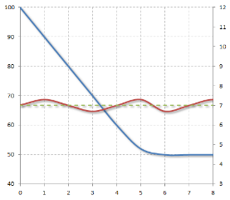
VARIABLE FLOW COMPATIBILITY
Evaporator
Designed to manage VPF*
SmartFlow Control
Algorithm designed to handle variations of 10% per minute
Maintains water temperature within ±0.3ºC
Ability to deliver a signal to control variable speed pump
Nom.
Flow
100%
VPF Area
±0.3ºC
%Flow variation
Leaving Water temp ºC
Min. Flow
50%
Max. Flow
150%
Time (minutes)
*Variable Primary Flow

Slide 10
SERIES COUNTERFLOW CONFIGURATION
Traditional Parallel piped chillers configuration
Series Series Configuration
1009 kW
37°C
35°C
30°C
27°C
32°C
10°C
1090 kW
15°C
965 kW
Chiller plant EER
improved
5°C
Series counterflow configuration
Improves system efficiency
Saves installation cost
Smaller diameter piping
Fewer pumps
Smaller pumps
Great opportunity for Free Cooling on first Chiller (if appropriate)
VPF operation further enhances system efficiency
1009 kW
12°C
7°C

Slide 11
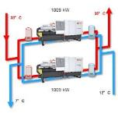
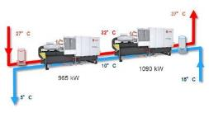
SERIES COUNTERFLOW CONFIGURATION
Example
 | Parallel Piped Chillers | Series Series Configuration | Benefits
Total Cooling Capacity | 2018 kW | 2055 kW
Chillers EER | 100% | 103% | Enhanced efficiency
Necessary Pump Power (Chillers only) | 5.6 kW 4 pumps | 6.2 kW 2 pumps | Lower installation Cost
Pipe run | Cooling Side : 1000 m Rejection side: 1000 m |  | -
Pipe Diameter | Cooling Side : 10” Rejection side: 10” | Cooling Side : 8” Rejection side: 8” | Reduced cost of piping
Total System Pump Power | 42 kW | 31 kW | Reduced System Pump Power

Slide 12
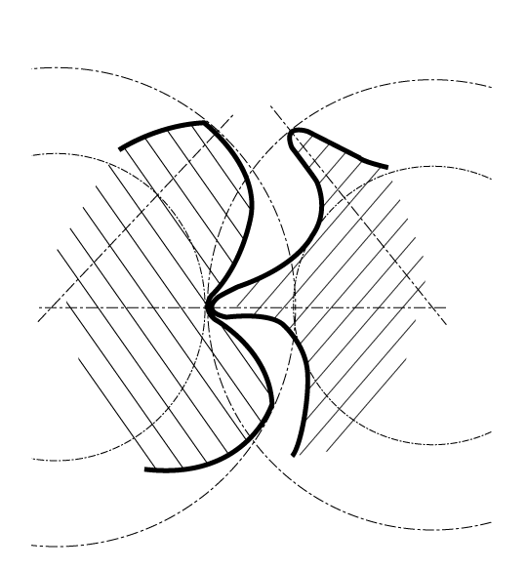
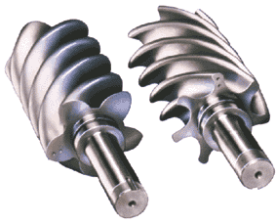
COMPRESSOR
More than 30 years of experience
Designed, built and tested according to the highest demanding and rugged standards
Proven track record
More than 300 000 compressors worldwide
Industry leading reliability: rate greater than 99.5%
Stable operation with no surge
Fewer moving parts
Direct drive low speed
Suction gas cooled
No oil pump needed
Resistance to liquid slugging
Field serviceable
Wider operating map in the industry
Notes:
Also refer to page 4 of brochure

Slide 13
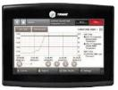
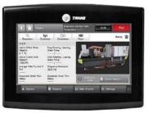
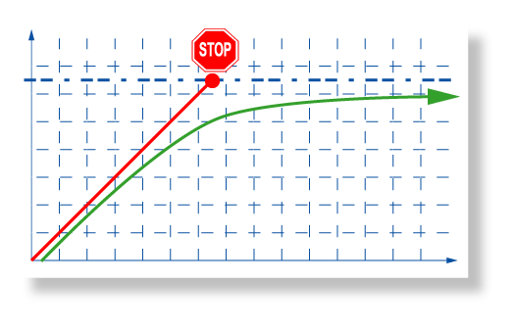
CONTROLS
Trane Adaptive ControlTM
Patented Industry leading algorithms
Takes actions to prevent shutdown due to abnormal operating conditions:
Flow failure
Cooling tower or Dry cooler malfunction
Extreme operating conditions
Clear visibility of operation through graphics:
Trend monitoring
Performance follow-up
Preventive maintenance anticipation
More than 100 diagnostics made when a fault is detected
Display indicates fault, time and date of diagnostic
Quick localization of problem
Faster action
Allows problem fixing without shutting off
Downtime minimized
Trend Charts
Intuitive Display in Local Language
Diagnostics
Trip point
Temperature
Trane Adaptive ControlTM
Traditional chiller shut-off
Time
Notes:
Also refer to page 4 of brochure

Slide 14
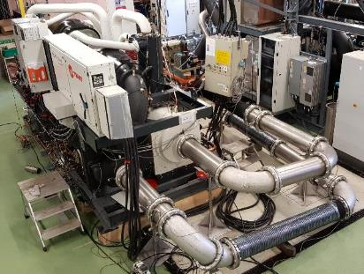
TESTING
Extended testing
Operation in extreme operating conditions leading to World Class reliability
Ambient Air: from -25ºC to 55ºC
Leaving Water: from -12ºC to 85ºC
Pressure vessels resistance
Electro-Magnetic compatibility (CE compliance)
Finite element analysis for structure and components design resistance and robustness
Acoustics and vibrations testing
Notes:
Also refer to page 4 of brochure

Slide 15
QUALITY STANDARDS
CE compliance
Pressure Equipment Directive (PED) 97/23/CE
Machinery Directive (MD) 2006/42/CE
Low Voltage Directive (LV) 2006/95/CE
Electromagnetic Compatibility Directive (EMC) 2004/108/CE
Electrical Machinery Safety Standard EN 60204-1
Electromagnetic Emission and Immunity Standard EN 61800-3 category C3
Quality Insurance processes
ISO9001
ISO14001
3rd Party certifications
Eurovent for units up to 1500 kW
AHRI for units above 700 kW
Guaranteed performance of the investment
Notes:
Also refer to page 4 of brochure

Slide 16
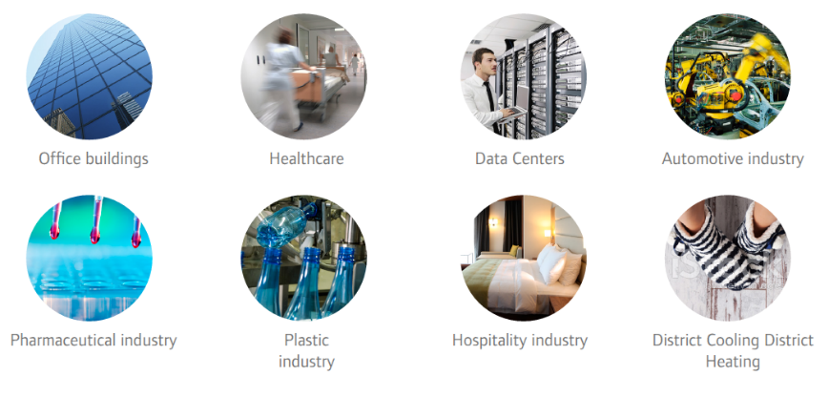
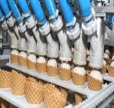
DESIGNED FOR MULTIPLE APPLICATIONS
In cooling or heating
Office buildings
Healthcare
Data Centers
Automotive Industry
Pharmaceutical Industry
Food and Beverage
Industry
Hospitality Industry
District Cooling
District Heating

Slide 17
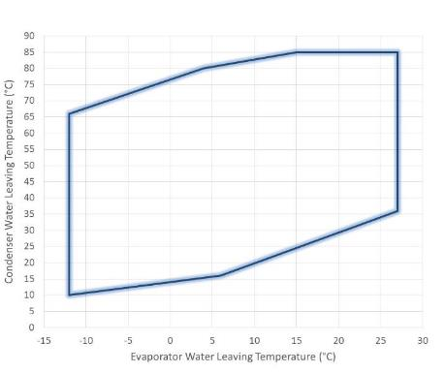
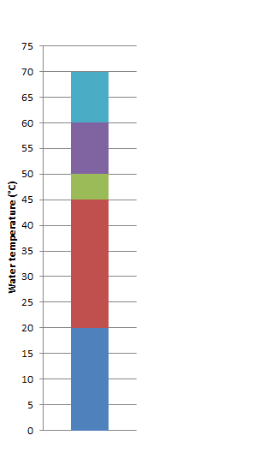
OPERATING TEMPERATURE RANGE
Extended Heating
Legionella Bacteria
Development
+85ºC
Instantaneaous Elimination
District and
conventional heating
90% Elimination
In 2 minutes
90% Elimination
In 2 hours
Comfort Cooling and Heating
Food &
Beverage
Industry
Cooling
Data centers
Cooling
Optimum temperatures
for bacteria growth
+28ºC
Bacteria alive
But inactive
-12ºC

Slide 18
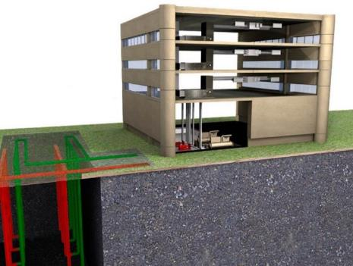
HEAT PUMP OPERATION
High leaving water temperature
Up to 85ºC
High capacity water/water heat pump
Up to 1.6 MW at 40/45ºC*
Up to 1.5 MW at 47/55ºC*
Up to 1.4 MW at 55/65ºC*
High COP**
Up to 4.8 at 40/45ºC*
Up to 4.0 at 47/55ºC*
Up to 3.2 at 55/65ºC*
Dedicated and optimized compressor for heating applications
* Entering/Leaving evaporator : 10/7ºC
** Net COP Calculated according to EN14511-2013 standard

Slide 19
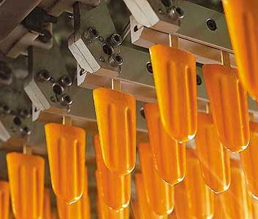
BRINE PROCESS APPLICATIONS
Compliant with Med Temp industrial process application minimum efficiency requirements (SEPR)
European regulation (EU) 2015/1095
Entry into force on 2016, July 1st
Operation from 4 down to -12ºC leaving water temp
Dedicated compressor for efficiency and reliability
Operation with various brines:
Ethylene Glycol
Propylene Glycol
Ethanol
Value of standardized design, capable to meet special requirements

Slide 20
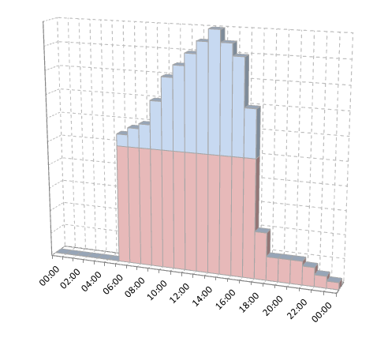
ICE STORAGE
Typical ice storage application
Energy storage application
Chiller builds ice when utility rates are lower, or when heating requirement overtakes cooling requirement
Chiller smartly balances the contribution of ice melting and chiller operation to meet the cooling load with the best system efficiency
Controls takes charge of:
controlling set points,
actuating chiller and or ice pump and other accessories
Building Load
Ice usage
Chiller usage
Time of the day

Slide 21
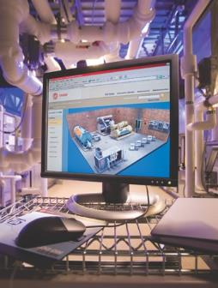
COMMUNICATION
Compatible with all Trane Building Management Systems and chiller plant controls
Communication interfaces
BACnet™ IP
BACnet™ MSTP
ModBus™ RTU
LonTalk™ (LCI-C)

Slide 22
Your expectations in one product
Capacity
Efficiency
Versatility
Reliability
kW

Slide 23
A unique portfolio for your needs
High Speed Centrif. Technology
GVWF G
GVAF
GVAF XPG
R134a
GVWF
R1234ze
RTHD
RTWD
RTWF
RTHF
RTWD G
RTWF G
RTHF G
New in
2018
RTAF
RTAF G
New in
2018
Screw Technology

