Slide 1

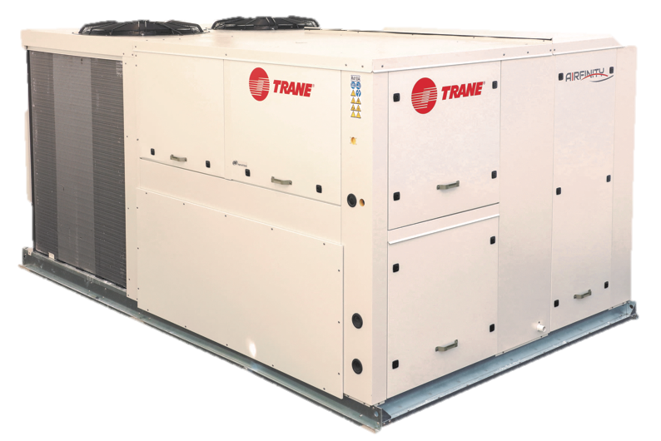
RT-CMS001-GB_0118
Easy-to-install high performance packaged rooftops.
Proven reliability. Total peace of mind.
Product Presentation

Slide 2


Agenda
The Airfinity™ Advantage
Product Range
Product Features
Energy saving solutions
Energy Recovery Solutions
Controls Solutions
Airfinity Solar

Slide 3





IDEAL performance
Seasonal efficiency compliant with EcoDesign Lot 21
Eurovent Class A or B
INTEGRATED solution
Compact and modular design with fully integrated controls
Designed for easy access and maintenance
INSTANT plug & play
Maximum adaptability for faster, easier, less expensive installations
Compatible with multiple roofcurbs – without expensive adapters or other modifications – even with a heat recovery module!
INTELLIGENT control
TRANE® software accumulating years of HVAC expertise
Free cooling and heat recovery solutions for lower total cost of ownership

Slide 4
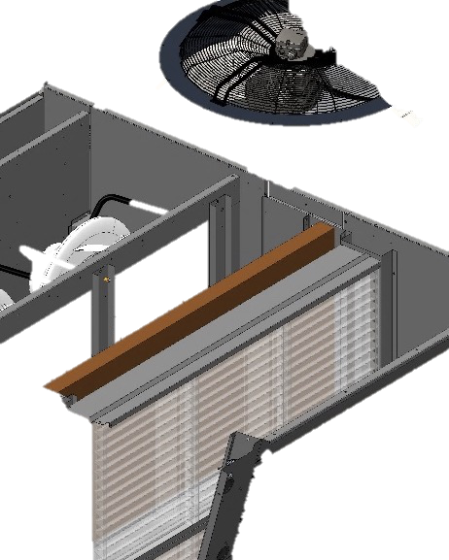
How does a rooftop (RTU) work?
Rooftops are a cost-effective, pre-engineered way of providing Heating, Ventilation and Air-Conditioning
Example for a horizontal flow application
Adaptable for many applications, preferably single-zone (retail spaces, warehouses…)
Designed for outdoor use, typically installed on a roof (can also be slab-mounted on the ground)
Air-conditioning and heating is performed by a R410A-based refrigeration circuit
Economizer allows pre-conditioning of fresh air to reduce mechanical work, and can allow RTU to operate in free cooling mode (ventilation only)
Supply air
Fresh air
Return air

Slide 5



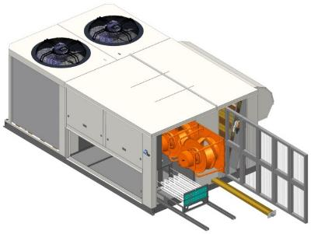



Value Across The Total Lifecycle
Easy installation
Customizable Return & supply air
Available static pressure up to 500 Pa
Plug & Play heat recovery options
Light weight design
Compatible with non-Trane roofcurbs
Easy start-up
Easy to adapt to customer installation
Airflow setting done in one minute
Use of standard components
Easy maintenance
Easy access to filtration and key components
Clogged filter detection
Alarm management
Remote control
Efficient operation
Eurovent Class A or B
High seasonal efficiency (SEER & SCOP)
Modulating airflow
Economizer for free cooling operation
Energy recovery options

Slide 6
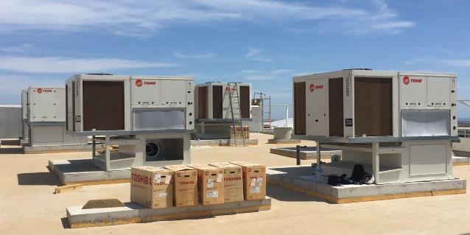
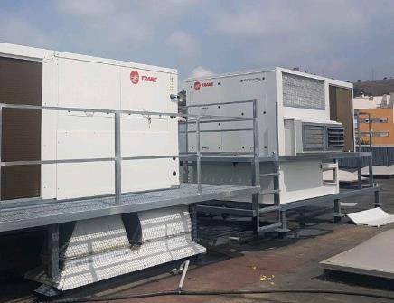
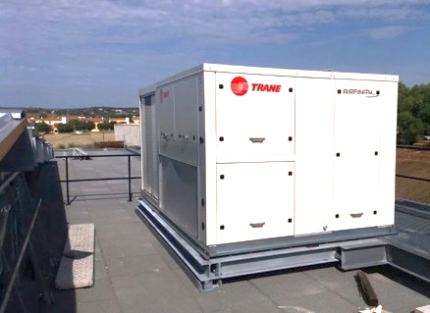
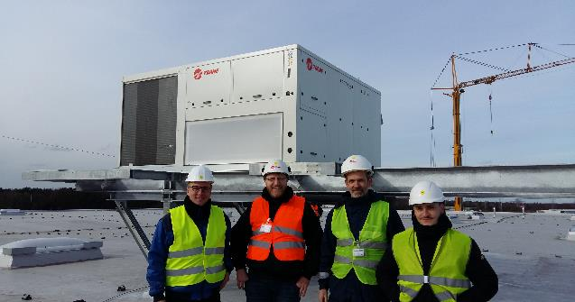
Example of real installations
IH065 w/ return roofcurb, Movie theater, Portugal
IH074 w/ERC, Supermarket, Spain
IH064, Grocery store, Portugal
IH130 w/ERM, Logistics center, Germany

Slide 7

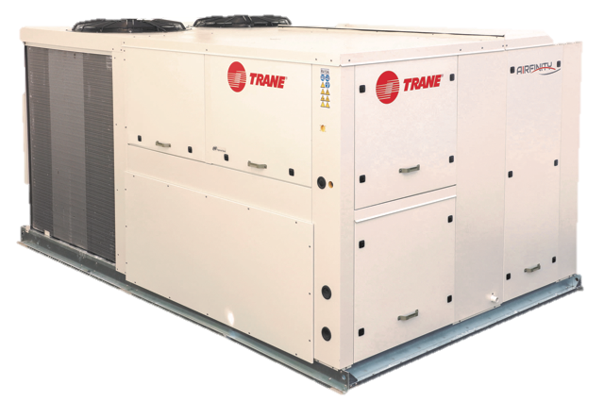



Product Range
Cooling only (IC)
35 – 135 kW
Reversible heat pump (IH)
35 – 135 kW
Auxiliary heating
Simplex and Duplex models
Integrated exhaust options
Energy recovery systems
Low ambient application
Room thermostat and interfaces
System control manager
Adapter roof curbs
Staged or modulating gas burner
Electric heater
Hot water coil
Solar
15 – 65 kW of installed PV power

Slide 8
IH Reversible Range
Airfinity Heat Pump IH |  | 040 | 050 | 060 | 065 | 075 | 085 | 100 | 110 | 130
Version |  | Duplex duo
Number of circuits / compressors |  | 2 / 4 | 2 / 4 | 2 / 4 | 2 / 4 | 2 / 4 | 2 / 4 | 2 / 4 | 2 / 4 | 2 / 4
Nominal airflow | (m3/h) | 8700 | 10600 | 12100 | 13700 | 15700 | 16700 | 19800 | 21600 | 25500
Performance data (cooling mode)
Net cooling capacity (1) | (kW) | 44 | 54 | 61 | 72 | 82 | 88 | 104 | 113 | 133.43
Total power input | (kW) | 14 | 17 | 20 | 24 | 27 | 30 | 34 | 40 | 50.68
Net EER |  | 3.23 | 3.11 | 3.05 | 3.01 | 3.03 | 2.91 | 3.02 | 2.81 | 2.63
Eurovent Energy class |  | A | A | A | A | A | B | A | B | C
Seasonal space efficiency in cooling | (%) | 149 | 147 | 145 | 143 | 144 | 143 | 146 | 137 | 125
SEER |  | 3.80 | 3.75 | 3.70 | 3.65 | 3.69 | 3.65 | 3.73 | 3.50 | 3.20
Performance data (heating mode)
Net heating capacity (1) | (kW) | 39 | 49 | 55 | 64 | 72 | 77 | 92 | 104 | 125
Total power input | (kW) | 11 | 15 | 17 | 19 | 21 | 23 | 27 | 31 | 39
Net COP |  | 3.27 | 3.25 | 3.21 | 3.28 | 3.41 | 3.32 | 3.43 | 3.32 | 3.21
Eurovent Energy class |  | B | B | B | B | A | B | A | B | B
Seasonal space efficiency in heating | (%) | 116 | 119 | 115 | 118 | 126 | 123 | 128 | 128 | 118
SCOP |  | 2.97 | 3.03 | 2.94 | 3.02 | 3.20 | 3.12 | 3.24 | 3.23 | 2.99
Auxiliary heat data
Auxiliary electric heating capacity - Stage 1 / 2 | (kW) | 12,5 / 12,5 |  | 12,5 / 25 |  |  |  | 25 / 37,5
Staged gas burner heat output (min. / max.) | (kW) | 42 / 52 | 42 / 52 | 60 / 74 | 60 / 74 | 82 / 100 | 82 / 100 | 82 / 100 | 82 / 100 | 82 / 100
Staged gas burner maximum efficiency | (%) | 91 | 91 | 92 | 92 | 92 | 92 | 92 | 92 | 92
Modulating gas burner heat output (min. / max.) | (kW) | 9 / 42 | 9 / 42 | 12 / 65 | 12 / 65 | 16 / 82 | 16 / 82 | 21 / 100 | 21 / 100 | 21 / 100
Modulating gas burner maximum efficiency | (%) | 96 | 96 | 97 | 97 | 98 | 98 | 97 | 97 | 97
General data
A-weighted Outdoor sound power level (2) | (dB(A)) | 84 | 84 | 85 | 85 | 85 | 85 | 85 | 85 | 91
A-weighted sound power level in duct (2) | (dB(A)) | 75 | 78 | 82 | 80 | 84 | 87 | 92 | 96 | 99
Weights and dimensions (Operating)
Length | (mm) | 3010 | 3010 | 3010 | 3010 | 3890 | 3890 | 3890 | 3890 | 3890
Width | (mm) | 2250 | 2250 | 2250 | 2250 | 2250 | 2250 | 2250 | 2250 | 2250
Height | (mm) | 1565 | 1565 | 1565 | 1565 | 1585 | 1585 | 1890 | 1890 | 1890
Weight (without options) | (kg) | 1100 | 1112 | 1116 | 1153 | 1342 | 1348 | 1566 | 1570 | 1570

Slide 9
IC Cooling Only Range
Airfinity Cooling only IC |  | 038 | 048 | 058 | 063 | 039 | 049 | 059 | 064 | 074 | 084
Version |  | Simplex |  |  |  | Duplex single
Number of circuits / compressors |  | 1 / 2 | 1 / 2 | 1 / 2 | 1 / 2 | 2 / 2 | 2 / 2 | 2 / 2 | 2 / 2 | 2 / 2 | 2 / 2
Nominal airflow | (m3/h) | 7800 | 9000 | 11100 | 12600 | 8300 | 10100 | 11300 | 12700 | 15700 | 17100
Performance data (cooling mode)
Net cooling capacity (1) | (kW) | 41 | 50 | 60 | 69 | 42 | 52 | 59 | 66 | 82 | 89
Total power input | (kW) | 14 | 17 | 21 | 25 | 15 | 19 | 21 | 25 | 27 | 31
Net EER |  | 2.97 | 3.01 | 2.92 | 2.76 | 2.87 | 2.81 | 2.82 | 2.63 | 3.03 | 2.86
Eurovent Energy class |  | B | A | B | C | B | B | B | C | A | B
Seasonal space efficiency in cooling | (%) | 144 | 143 | 141 | 136 | 121 | 119 | 118 | 117 | 122 | 120
SEER |  | 3.66 | 3.64 | 3.59 | 3.47 | 3.10 | 3.04 | 3.01 | 3.01 | 3.13 | 3.06
Auxiliary heat data
Auxiliary electric heating capacity - Stage 1 / 2 | (kW) | 12,5 / 12,5 |  |  |  |  |  | 12,5 / 25
Staged gas burner heat output (min. / max.) | (kW) | 42 / 52 | 42 / 52 | 60 / 74 | 60 / 74 | 42 / 52 | 42 / 52 | 60 / 74 | 60 / 74 | 82 / 100 | 82 / 100
Staged gas burner maximum efficiency | (%) | 91 | 91 | 92 | 92 | 91 | 91 | 92 | 92 | 92 | 92
Modulating gas burner heat output (min. / max.) | (kW) | 9 / 42 | 9 / 42 | 12 / 65 | 12 / 65 | 9 / 42 | 9 / 42 | 12 / 65 | 12 / 65 | 16 / 82 | 16 / 82
Modulating gas burner maximum efficiency | (%) | 96 | 96 | 97 | 97 | 96 | 96 | 97 | 97 | 98 | 98
General data
A-weighted Outdoor sound power level (2) | (dB(A)) | 81 | 84 | 84 | 85 | 85 | 85 | 85 | 85 | 86 | 86
A-weighted sound power level in duct (2) | (dB(A)) | 83 | 88 | 93 | 97 | 83 | 88 | 93 | 97 | 84 | 87
Weights and dimensions (Operating)
Length | (mm) | 2830 | 2830 | 2830 | 2830 | 3010 | 3010 | 3010 | 3010 | 3890 | 3890
Width | (mm) | 2250 | 2250 | 2250 | 2250 | 2250 | 2250 | 2250 | 2250 | 2250 | 2250
Height | (mm) | 1575 | 1575 | 1575 | 1575 | 1565 | 1565 | 1565 | 1565 | 1585 | 1585
Weight (without options) | (kg) | 914 | 985 | 985 | 985 | 988 | 1005 | 1016 | 1016 | 1333 | 1347

Slide 10
IC Cooling Only Range
Airfinity Cooling only IC |  | 040 | 050 | 060 | 065 | 075 | 085 | 100 | 110 | 130
Version |  | Duplex duo
Number of circuits / compressors |  | 2 / 4 | 2 / 4 | 2 / 4 | 2 / 4 | 2 / 4 | 2 / 4 | 2 / 4 | 2 / 4 | 2 / 4
Nominal airflow | (m3/h) | 8700 | 10100 | 12100 | 14000 | 16100 | 17300 | 20200 | 22200 | 26000
Performance data (cooling mode)
Net cooling capacity (1) | (kW) | 43 | 53 | 62 | 73 | 84 | 91 | 109 | 123 | 136
Total power input | (kW) | 14 | 19 | 20 | 24 | 28 | 31 | 36 | 44 | 52
Net EER |  | 2.97 | 2.83 | 3.07 | 3.02 | 3.02 | 2.96 | 3.03 | 2.81 | 2.63
Eurovent Energy class |  | B | B | A | A | A | B | A | B | C
Seasonal space efficiency in cooling | (%) | 140 | 135 | 132 | 139 | 137 | 138 | 138 | 131 | 121
SEER |  | 3.57 | 3.45 | 3.38 | 3.55 | 3.50 | 3.53 | 3.52 | 3.34 | 3.09
Auxiliary heatdata
Auxiliary electric heating capacity - Stage 1 / 2 | (kW) | 12,5 / 12,5 |  | 12,5 / 25 |  |  |  | 25 / 37,5
Staged gas burner heat output (min. / max.) | (kW) | 42 / 52 | 42 / 52 | 60 / 74 | 60 / 74 | 82 / 100 | 82 / 100 | 82 / 100 | 82 / 100 | 82 / 100
Staged gas burner maximum efficiency | (%) | 91 | 91 | 92 | 92 | 92 | 92 | 92 | 92 | 92
Modulating gas burner heat output (min. / max.) | (kW) | 9 / 42 | 9 / 42 | 12 / 65 | 12 / 65 | 16 / 82 | 16 / 82 | 21 / 100 | 21 / 100 | 21 / 100
Modulating gas burner maximum efficiency | (%) | 96 | 96 | 97 | 97 | 98 | 98 | 97 | 97 | 97
General data
A-weighted Outdoor sound power level (2) | (dB(A)) | 84 | 84 | 85 | 85 | 85 | 85 | 85 | 85 | 91
A-weighted sound power level in duct (2) | (dB(A)) | 75 | 78 | 82 | 80 | 84 | 87 | 92 | 96 | 99
Weights and dimensions (Operating)
Length | (mm) | 3010 | 3010 | 3010 | 3010 | 3890 | 3890 | 3890 | 3890 | 3890
Width | (mm) | 2250 | 2250 | 2250 | 2250 | 2250 | 2250 | 2250 | 2250 | 2250
Height | (mm) | 1565 | 1565 | 1565 | 1565 | 1585 | 1585 | 1890 | 1890 | 1890
Weight (without options) | (kg) | 1100 | 1112 | 1116 | 1153 | 1342 | 1348 | 1566 | 1570 | 1570

Slide 11


Wide range of options
Energy recovery
Enthalpy wheel
Thermodynamic heat recovery
Building pressurization
And much more!
Barometric relief damper
Exhaust Fan (RESP = 70 Pa)
High speed Exhaust Fan (RESP=140 Pa)
Return roofcurb (RESP = 250 Pa)
Heat recovery module
Dehumidification
Low ambient
Dirty filter detection
And more…
Filtration
G4 (standard)
G4 (50 mm) + F7 (100 mm)
F5 (50 mm) + F7 (100 mm)
G4 (50 mm) + F9 (100 mm)
Airflow configuration
Vertical return/supply
Horizontal return/supply
Vertical return / horizontal supply
Horizontal return / vertical supply
System control
Auxiliary heat
Tracer® Concierge
Tracer® SC
Easy BAS integration through ModBus, LonTalk, or BacNet protocols
Electric heater
Hot water coil
Gas burner (2-stage or modulating)

Slide 12

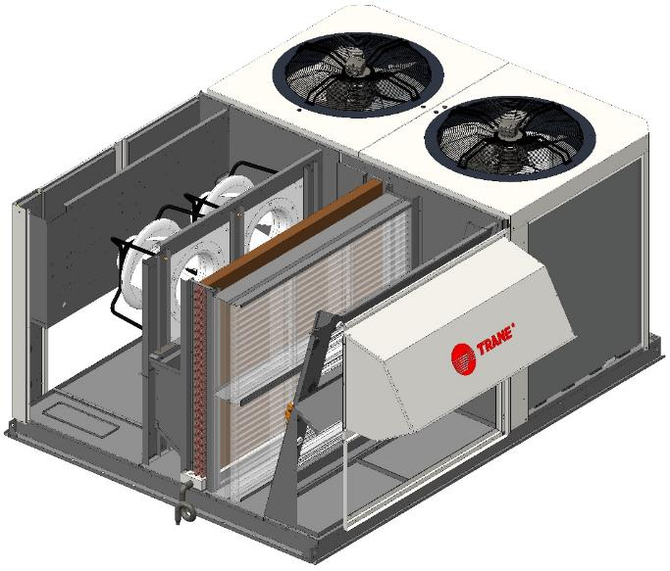



Air Handling Section
EC Plug Fan
Compact, quiet and more efficient compared to traditional axial fans. Rail system for easy access and maintenance.
Double skin panel
Double wall and 25mm glass wool insulation provided as standard with all units, for higher indoor air quality.
Air Filtration
Two rails for wide range of filtration up to F9. G4 provided as standard.
Economizer
Provided as standard to enable free cooling functionalities
Sloped drain pan
Full aluminum sloped drain for improved condensate management, thus preventing formation of microbial agents
Energy
Comfort
Building Pressurization control
Barometric relief, exhaust fan and return fan available as optional to avoid overpressure in the building
Air Quality

Slide 13
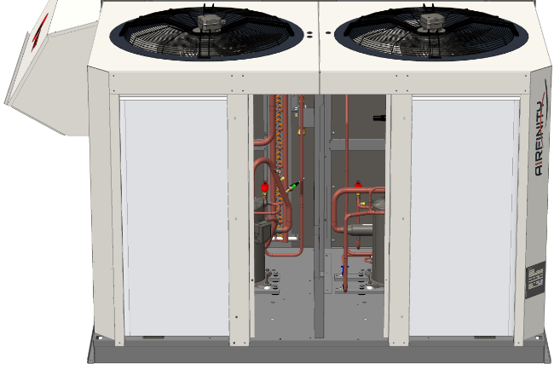
Refrigeration Section
Axial fans
High efficiency axial fans. EC fans available as an option
Scroll compressors
High performance in part load thanks to capacity modulation
Electronic Expansion Valve
Thanks to its tight control and ability to operate at a lower condensing pressure, the EEV creates additional opportunities for energy savings.
Easy-access panels
Can be removed easily using a common turn-key (no screws!). Prevents corrosion and missing components after service.
Energy
Epoxy coating
High quality Epoxy coating prevents corrosion and extends unit lifetime
Comfort
Reliability

Slide 14
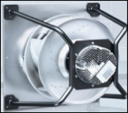
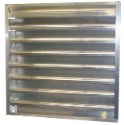
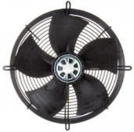
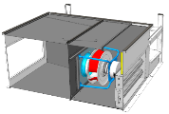
Building pressurization solutions
Variable Airflow
Direct drive fan with EC Motor
Variable airflow control strategy
Airflow measurement in real time
Barometric Damper
Barometric relief with no pressure control
Damper opens when ∆p > 5Pa (inside the building)
% of Exhaust air is driven by the Economizer opening
Tighter control, higher return duct pressure drop
Exhaust
Fan
AC Motor Axial Fans (450mm)
2 ESP available : 70Pa & 140Pa
Maximum extracted airflow: 40% of supply airflow
Roofcurb equipped with EC plug fans
Delivers an additional ESP of at least 250Pa
Return fan RPM is a function of supply fan airflow
Manages up to 100% of the supply airflow
Return Roofcurb

Slide 15
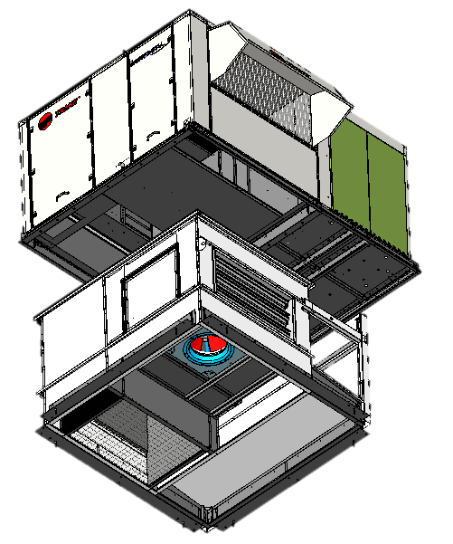
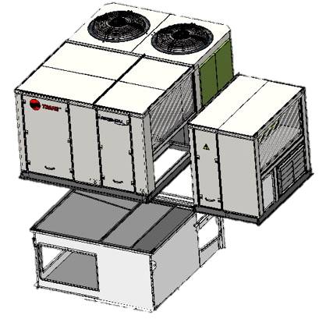
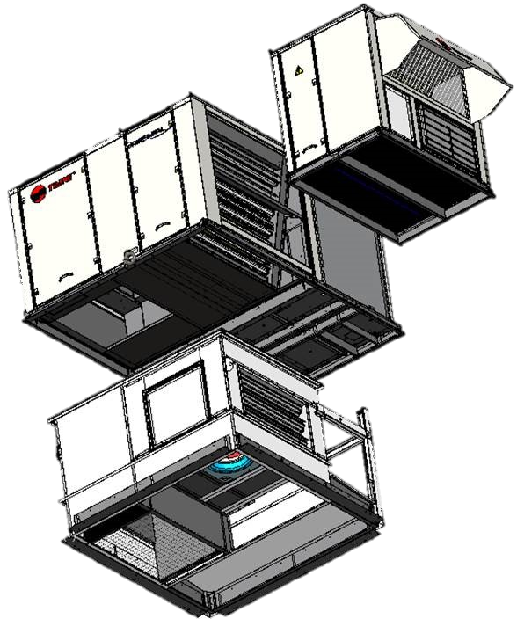
Airflow configurations
Example 1
Example 2
Example 3
Vertical supply & return
With return roof curb
Horizontal supply & return
w/ Energy Recovery Module
and Multi-directional roof curb
Vertical supply & return
w/ Energy Recovery Module
and return roof curb
LEGEND
Fresh air
Exhaust air
Supply air
Return air
Recycled air

Slide 16
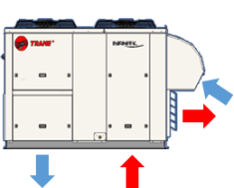
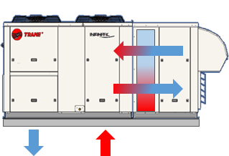
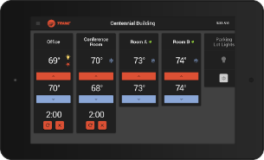
Want to reduce your energy bill?
Intelligent Free Cooling
Managed by Trane controller for maximum energy savings
Comparative Enthalpy control measures both temperature and humidity to determine favorable conditions for free cooling
Up to 100% fresh air management
Heat Recovery
Light and compact without need for additional roofcurb
Plug & play solution – easy on-site installation
Designed by Trane for optimized performance
Reliable technology, even in extreme winter conditions
Tracer Concierge™
Ideal for retail applications
Change HVAC and lighting schedules using one interface
Make allowable temperature and humidity set point changes
Receive notification of HVAC unit conditions or problems
User-friendly display panel allows limited adjustments
Compatible with wireless technology
See video: https://youtu.be/YAWt0QIJo-o

Slide 17
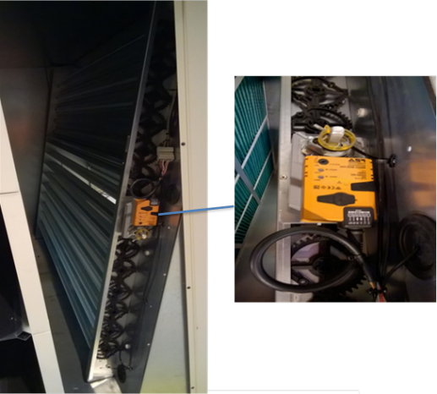
Fresh Air & Free Cooling
Thanks to the Economizer, provided as standard on all Airfinity™ units, you can take full advantage of outdoor conditions while utilizing fresh air, in order to reduce your operating costs.
Adjustable minimum fresh air %
or
Intelligent fresh air management (Free Cooling)
Dry Bulb Control (Δ°C)
or
Enthalpy control (ΔkJ/kg)
or
Demand ventilation control, based on:
  CO2 level in the room
  Occupied/Unoccupied mode
  Morning warm-up
  Etc.
ModBus-driven technology for easy integration with BMS
Notes:
The Economizer will always take advantage of cooler outdoor air to satisfy a cooling load in a conditioned space minimizing the need for mechanical cooling (with compressors). Thanks to the Trane CH536 Controller, you won’t have to do a thing – the machine will automatically switch to free cooling mode every time it sees an opportunity to reduce energy consumption.
The damper is driven by a Modbus device, which makes it very easy to connect directly to the BMS, in order to control ventilation from an external input.
Free cooling Control strategies available:
1) Dry Bulb Control (only compares indoor and outdoor temperatures): “RAT - OAT > 2°C”
2) Enthalpy comparative (compares indoor and outdoor ENTALPHY, which includes both temperature and humidity, thus taking into account the full energy content in the air. Using this control strategy can offer more possibilities for energy savings. “RAE – OAE > 7kJ/kg” (optional)
Fresh air management:
Default: Free cooling - Machine will compare outdoor and indoor conditions and, when favorable, introduce fresh air into the building in order to promote free cooling. Machine will always privilege free cooling, unless indicated otherwise by the customer (via service terminal).
Optional: Demand ventilation (configured during commissioning → customer can choose how he wants to control the introduction of fresh air into the building.
Examples:
- CO2 level in the room: « Increase ventilation when CO2 level, i.e. number of people in the room is higher than XYZ »
- Occupied/unoccupied: Reduce airflow to 10% when the building is unoccupied (can be defined using the scheduling function in the THP04 thermostat)
-

Slide 18
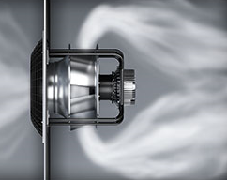
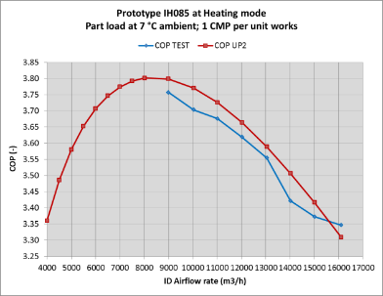
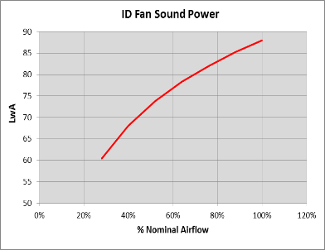
Modulating Airflow
For a typical retail application, your rooftop unit will run in part load more than 95% of the time.
That’s why we integrated EC plug fans with modulating airflow as a standard on all Airfinity™ units, so that you can maximize comfort and efficiency… especially at part load conditions!
Efficiency Gain at part load
Lower Noise 95% of time
Comfort & Reliability
Prevent cold shower effect
Less air stratification when using auxiliary heat
No rubber dust due to belt wearing
Limited vibrations
Reduced starting amps (compliant with textile ducts)
Airflow setting on front panel for quick start-up and commissioning
Lower weight / lower installation cost
PL Eff% = Up to 15% gain

Slide 19
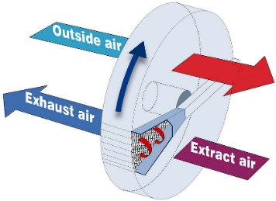
Energy Recovery Systems
Two alternative energy recovery systems are offered with free-cooling capability and integrated exhaust fan
Energy Recovery Module (ERM)
Trane’s ERM utilizes the enthalpy wheel, thanks to its capability to transfer both heat and moisture. While the wheel rotates through the two air streams, it absorbs sensible heat and moisture from the hot, humid air stream and releases it into the cooler, drier air stream.
Energy Recovery Circuit (ERC)
Trane’s ERC consists of an additional refrigeration circuit, which recovers energy from the exhaust air to pre-heat, or pre-cool the fresh air. The result is a reduction of compressor’s shaft work required to heat or cool the building.
Outside air
Exhaust air
Extract air

Slide 20
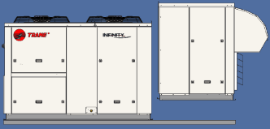

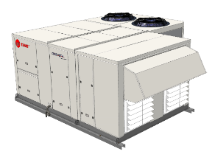
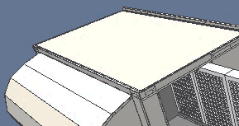
Energy Recovery Module
1
Convenient
Plug & Play: main unit pre-configured in the factory
Quick installation: No additional roofcurb required!
Light and compact: for easy transportation and handling
Efficient
High ROI: Typical payback of 2 to 3 years
Tight insulation: Double sheet metal skin
Free cooling: thanks to bypass damper and controls
Reliable
Freeze protection for low ambient applications
Easy access to key components
G4 filter included to protect the wheel
2

Slide 21
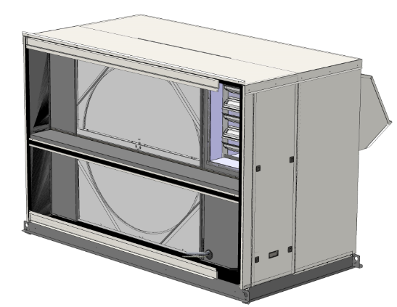

Energy Recovery Module
System components
Enthalphic Rotary Wheel
Fresh air hood
Fresh air filter
Temperature sensors
(protection against frost)
Barometric relief damper
Bypass damper
(for up to 100% fresh air circulation and free cooling)
Exhaust fan
High efficiency Plug fan

Slide 22
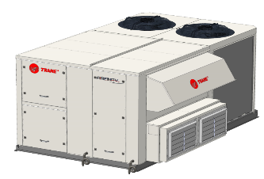
Energy Recovery Circuit
System components
Recovery coil
Between Filters and indoor coil
Exhaust coil
4-way valve
Barometric relief damper
Exhaust fan
High efficiency Axial fan
Scroll compressor

Slide 23
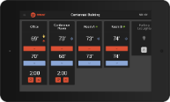




Unit & System Controls
Tracer SC
Tracer Concierge™
Comfort
Advanced
Remote monitoring and control
Alarm and event reporting
Trending analytics
Manage HVAC settings and schedule
Make allowable temperature and humidity set point changes
Alarm push notifications
Manage HVAC settings and schedule
Manage lighting schedules
Make allowable temperature and humidity set point changes
Alarm push notifications
PGD
Service terminal
CH536
Unit controller
THS04
User interface
Read and modify unit parameters
Alarm management
Remote unit control
Can be mounted inside the building
BacNet MS/TP interface
Web-based
Mobile app
Temperature and airflow control
Fresh air management
Free cooling and heat recovery control
Auxiliary heating control
LONTalk, ModBus, BacNet
Temperature and humidity setpoint adjustment
Fresh air management
BacNet MS/TP interface
Mobile app
Optional tablet display
Single unit
Single or multiple zones
Installation size

Slide 24
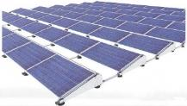
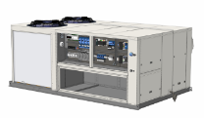



Airfinity™ Solar
PV generation
Solar ready
DC
By installing solar panels to power your HVAC equipment, you can reduce your carbon emissions and peak time electricity consumption.
At the same time you can put unexploited rooftop space to good use while protecting your operation from future electricity price fluctuations.
Building
Electric
cabinet
Exported power
Electric
meter
Imported power

Slide 25
Airfinity™ Solar
PV generation
Solar ready
Value solution: Designed for high performance, easy installation and trouble-free operation in combination with the Trane Airfinity™ rooftop
Complete package: You no longer need to think about your PV installation and HVAC equipment separately. Trane can provide you with the complete package, ensuring you have the optimum design for your installation.
Independent and reliable: The system is designed to be entirely based on self-consumption, which means you can eliminate the heavy bureaucratic load traditionally associated with these kinds of systems.
Ideal for BREAAM / LEED building certification: Increase the value of your property by using completely renewable and sustainable technologies
DC
Building
Electric
cabinet
Exported power
Electric
meter
Imported power
Contact your Trane Representative today for a simulation!

Slide 26
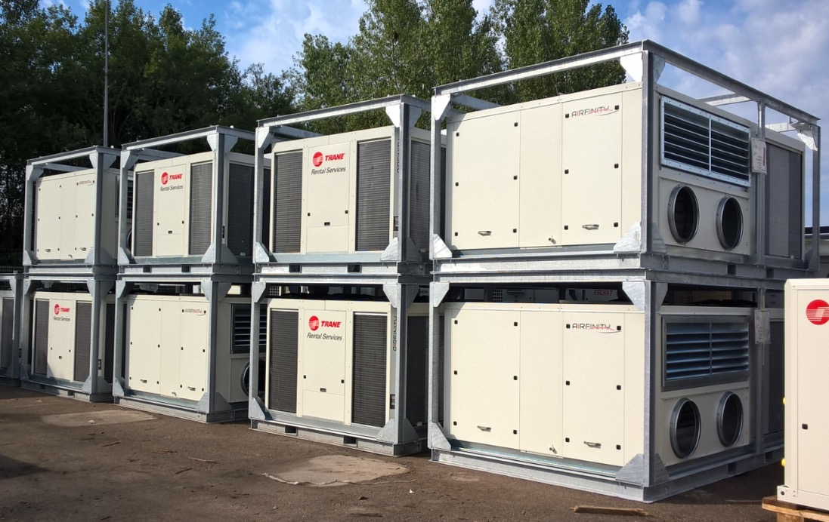
Trane Rental Services
Airfinity™ units now available in the fleet

Slide 27



For more information on Airfinity™ and other Trane® products, contact your local Trane Sales representative:
or visit: www.trane.eu

